Slide 1
Unit 1 Review

Slide 2
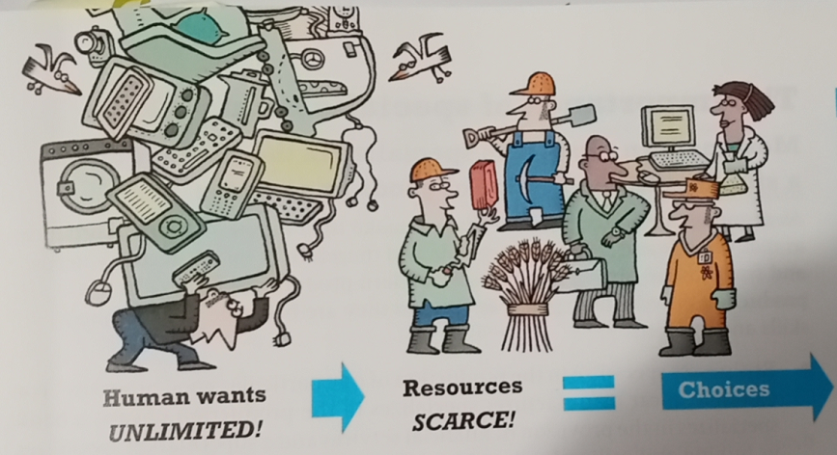
The Fundamental Economic Problem
Humans face huge numbers of choices because we usually don’t have enough resources to get everything that we want!
If you have two weeks of holiday. You can’t go to Europe and Africa and the United States because you won’t have enough time, money, energy etc.
The same applies to businesses. A business may have to choose between hiring new workers or fixing a broken machine if they don’t have enough money for both!
Summary:
We must make choices all the time because our resources are scarce.

Slide 3
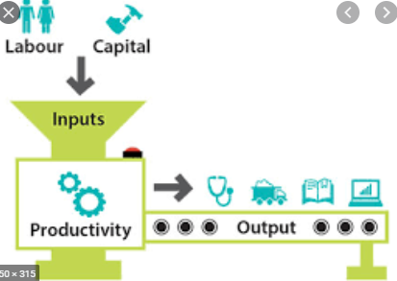

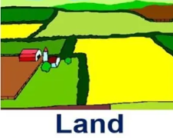



Factors of Production
Production
Resources (or inputs) are what businesses use to make the goods and services (or output).
This is called production.
We can put all business resources into four categories
Land
Labor
Capital
Enterprise
We call these the Factors of Production (FoP)

Slide 4




Factor Incomes
These come from the ownership of the factors of production.
Factor of Production | Factor Income Name | Example
Land | Rent | A businessman owns an apartment in Miami, Florida and collects rent each month.
Labor | Wages | A doctor works for a hospital and is paid for his labor.
Capital | Interest | A bank lends money to a couple who buy a house. They receive interest payments. An owner of a taxi receives money from someone who pays to drive it.
Enterprise | Profit | An investor who owns shares in Apple receives dividends every 6 months.

Slide 5

Opportunity Cost
We have established that the fundamental economic problem is limited resources and unlimited wants, so we have to make choices.
Each time we make one of these choices, we give up the other alternatives.
We often talk about the concept of opportunity cost.
Opportunity cost definition: The value of the next best opportunity or choice foregone.
Perhaps the lunch is free, but what about the time you’ve given up? Maybe you could have spent time with your family instead? Or watched a movie?
Eg. If you go to McDonalds and order a Big Mac, the opportunity cost is ordering nuggets which was your next choice.
Where are you right now? What is the opportunity cost?
Answer: You’re at school. You gave up the satisfaction of staying at home and sleeping!
Every decision. Everything anyone does has an opportunity cost because we gave up benefits from another choice.

Slide 6


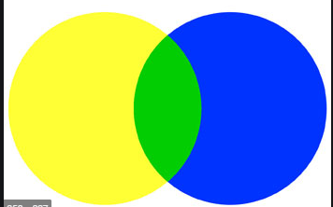
Main Economic Systems
An economic system answers the questions of:
What to produce
How to produce it
For whom to produce
Market Economy
Planned
Mixed
Decisions are made by private businesses.
Decisions are made by the government.
This is a mix of the first two!
Decisions are made by private businesses and the government.
Almost all countries have this system.
Free market
Free enterprise
Capitalism
Command
State Run
Communism

Slide 7


Positive vs Normative Economics
There are two types of statements in Economics (but also other fields).
Positive – statements that can be tested with data and hard facts. Note: They can be incorrect!
Can be supported by the use facts, numbers and uses neutral language. Often focuses on ‘cause and effect’ and can be verified through experiments.
Eg. Unemployment has increased by 3%.
This statement is easily measurable and less open to debate.
Normative – statements based more on opinion and people’s values and beliefs.
Will sometimes contain expressions such as ‘should’, ‘in my opinion’ and more emotional words.
Eg. Improving society’s technology level is more important than the happiness of our citizens.
This statement is more an opinion because it does not have any clear evidence to support it. Other people may have very different opinions.
Note: Positive has a different meaning in this context. Positive doesn’t mean that these statements are good or nice but rather able to be shown with evidence.

Slide 8
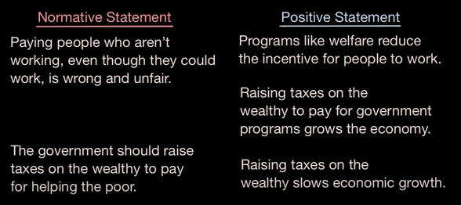

Slide 9
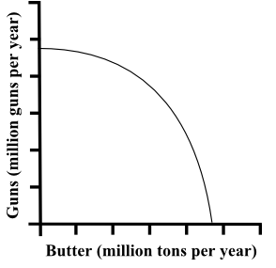
The PPC
Alternate Names:
opportunity cost curve
production possibility boundary (PPB)
production possibility frontier (PPF)
Summary
The PPC shows all the different possibilities of production.
A beneficial way to illustrate the concept of opportunity cost and tradeoffs is through the production possibility curve (PPC).
What is it? The PPC demonstrates the maximum possible combination of output produced, given the available resources and technology, within a specific country.
The PPC is based on the assumption that the country produces only two goods (i.e., for purposes of simplification). The boundary of the PPC is the connecting line between various output combinations.
The line shows the different bundles of production of two different goods.

Slide 10
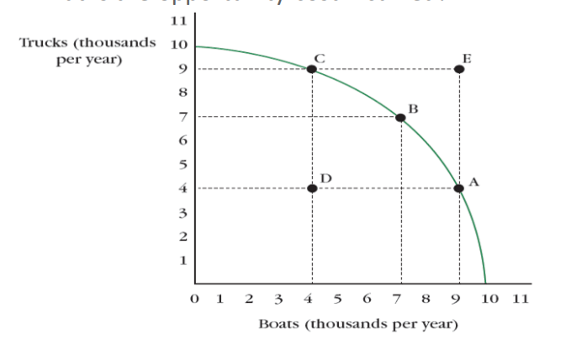
Efficient
Efficient – on the PPC
At this point all resources are being fully utilized.
Inefficient – inside the PPC
Not all resources are being utilized.
Unattainable – outside the PPC
Production that cannot be achieved because there are insufficient resources ie. factors of production
Eg. Machines, labor, land, technology etc.
Unattainable
Efficient
Inefficient
Efficient

Slide 11
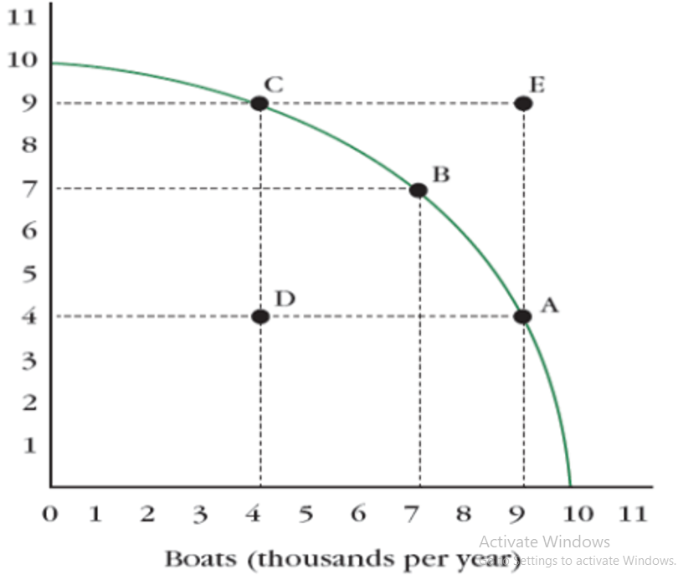
The PPC shows opportunity cost
Summary
Increase one good = produce less of another (when we are ON the PPC)
This is opportunity cost.
In life we see so many examples of tradeoffs.
The PPC shows how tradeoffs naturally occur.
When we are producing efficiently, in order to increase the output of Good A, we must decrease the output of Good B. So this shows an opportunity cost!
Trucks
(1000 per year)
If we move from point C to point B:
When we are efficient: Increasing trucks = decreasing boats.
There is an opportunity cost of producing more boats is what we gave up in trucks:
OC = 2000 trucks / 3000 boats = 0.7 trucks per 1 boat
As an approximation (because the graph is actually curved)

Slide 12
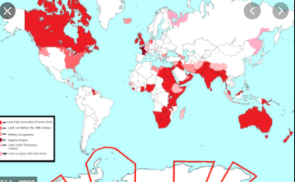


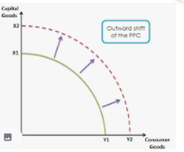
Outward shift of the PPC
Faster trains allow for faster and cheaper movement of goods/services, people and ideas.
This means that we can produce more of most goods.
England was originally a relatively small country in Europe which colonized many other countries. This pushed out their PPC as they had more land to help them produce more of a wide variety of goods.
Increase in Resources
Technology Increase
Note: This is one representation of economic growth, which is looked at several times in AP Macro.

Slide 13
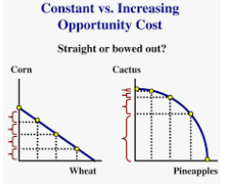
Which one is more realistic?
Increasing Opportunity cost
Summary
Straight = constant O.C.
Curved = increasing O.C.
Revision Link
When you use land that is good for pineapples to grow cactus, you’ll give up lots of pineapples and grow only a few extra cactus.
Constant opportunity cost
Resources are equally suited for all production
EASILY ADAPTABLE
Increasing opportunity cost
Resources are NOT equally suited for all production
NOT EASILY ADAPTABLE

Slide 14
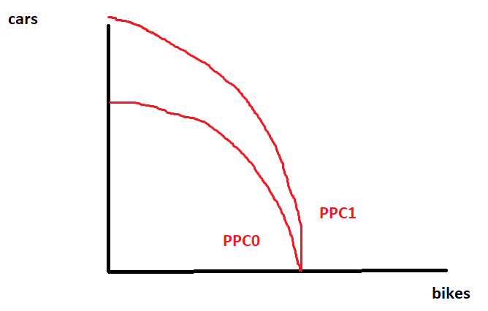
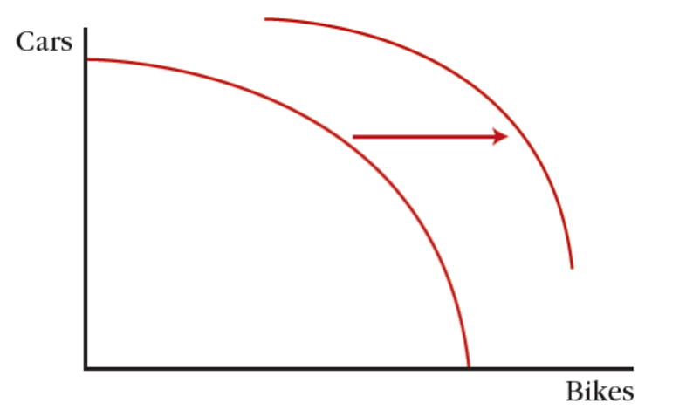
Increases in Resources/technology can shift the PPC

Slide 15
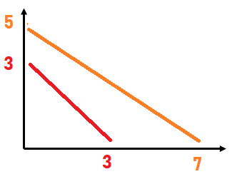
Absolute and Comparative Advantage
Another example
 | Good A | Good B
Country A | 5 (OC = 3/5) | 3(OC = 5/3)
Country B | 7(OC = 7/7) | 7(OC = 7/7)
Absolute advantage – being able to produce more in total
(sometimes it is also producing more while using the same amount of resources)
Country B has absolute advantage in both goods.
Comparative Advantage – Having the lower opportunity cost (ie. giving up less units of the other good)
Country A: comparative advantage in Good A.
Country B: Comparative advantage in good B.
Country | Output Wine | Output Cheese
Australia | 3 | 3
France | 5 | 7

Slide 16
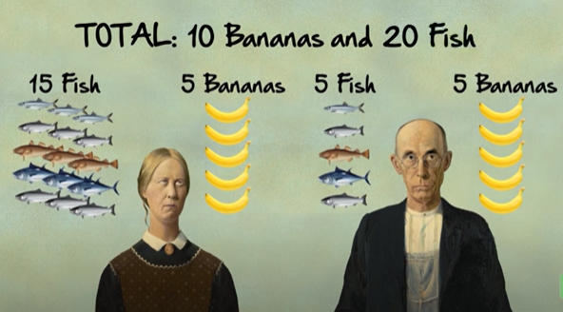
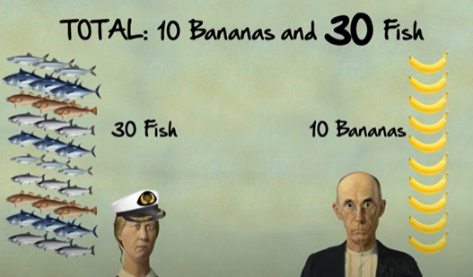
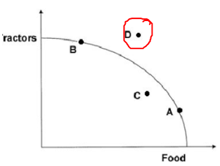

Gains From Trade
Before Specializing
After Specializing
By specializing according to comparative advantage and then trading, both Bob and the woman can consume beyond their PPC at point D.

Slide 17
Terms of Trade Example
 | Capital Goods | Consumer Goods
Pakistan | OC = 2/3 | OC=3/2
Uzbekistan | OC = 1/4 | OC = 4/1
Uzbekistan is making the capital goods.
From Uzbekistan (Seller) perspective:
The cost of production is ¼ (of a consumer good) so they will sell for something more than 1/4
From Pakistan (Buyer) perspective:
They currently pay 2/3. So they will want to pay 2/3 or less.
So, any price in between these two prices will benefit both buyer and seller.
Therefore ¼ consumer good ≤ 1 capital good ≤ 2/3 consumer good
The range of acceptable prices is just between the lowest and highest price!
Note:
because we don’t have $, all prices are expressed in terms of the OTHER good. Ie. 1 capital good costs 2/3 consumer good
In defining the terms of trade equation, put the seller on the left, and 1 of whichever good in the middle
Therefore 3/2 capital goods ≤ 1 consumer good ≤ 4/1 capital good

Slide 18
Solving a Trade and Comparative Advantage Question – Full Method
Country | Output Wine | Output Cheese
Australia | 3 | 4
France | 5 | 5
1. Find the opportunity costs
“What you give up” / “What you gain”
The ‘other good’ / the good you are calculating the OC for
2. Circle the lowest opportunity costs for each good – the country with the lower OC has comparative advantage.
Note: It will always be a diagonal!
3. Find the terms of trade – it will be any price between the lowest and highest price for each good.
4 cheese /3 wine = 4/3
3 wine /4 cheese = 3/4
5 cheese /5 wine = 1
5 wine /5 cheese = 1
Terms of trade:
For Wine: between 1 cheese and 4/3 cheese
ie. 1 cheese≤ 1 wine ≤ 4/3 cheese
For Cheese: between 3/4 wine and 1 wine
3/4 wine≤ 1 cheese ≤ 1 wine

Slide 19
When the Question is in terms of inputs (not outputs)
Country | Inputs to make wine | Inputs to make cheese
Aus | 4 hrs | 4 hrs
Fra | 5 hrs | 3 hrs
Method 1:
Prestep: Convert the numbers to output by dividing each number by the same numerator.
Now that the table is in terms of output you can perform the same steps as usual.
1/1 = 1
1/1 = 1
4hrs / 1 unit / 4 hrs = 1 unit
4hrs / 1 unit / 4 hrs = 1 unit
4hrs / 1 unit / 5 hrs = 0.8 unit
4hrs / 1 unit / 3 hrs = 4/3 unit
4/3 / 4/5 = 20/12 = 5/3
4/5 / 4/3 = 12/20 = 3/5
Method 2:
Reverse the OC calculation (so that instead of ‘the other good’ being the numerator, it is now the denominator
Choose the smallest numbers as usual
Using Method 1:
1 Prestep (red)
2 Opportunity Cost (purple)
3 Lowest opportunity cost
4 Comparative Advantage
Cheese: France , Wine: Australia
5 Terms of trade: 1 wine for (1 cheese to 5/3 cheese) OR 1 cheese for (3/5 to 1 wine)

Slide 20
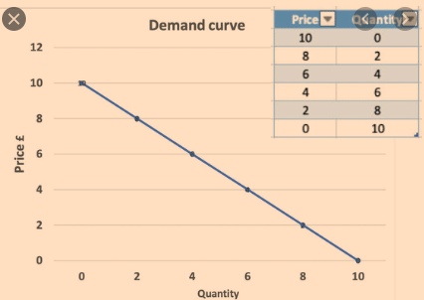
The Law of Demand
The demand curve slopes down.
The lower the price the more people will buy of something.
There is a negative/inverse relationship between the price of a good and the quantity bought.
Definition: Demand
The quantity of a product or service that consumers are willing and able to buy at a particular price.
Summary: Law of Demand
Price goes down, people buy more

Slide 21
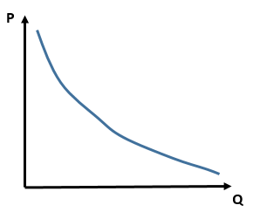

Three Reasons for the Law of Demand
We have established the law of the demand – the demand curve slopes down!
There are three reasons for this.
1. Diminishing Marginal Utility
2. The Income Effect
3. The Substitution Effect

Slide 22
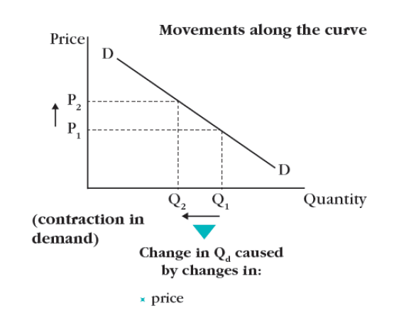
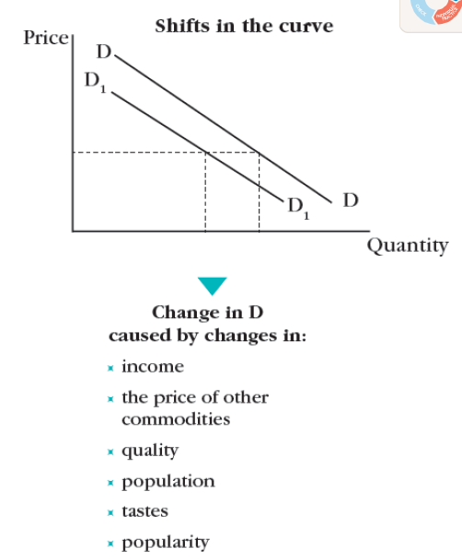
Price change
Non-Price Factors
Movements along the SAME curve
Movements of the WHOLE curve left and right
Contraction
Extension
Also called:
Determinants of demand
Summary:
Change of price – movement along curve (but the curve itself doesn’t move)
Change in other factors – curve moves left or right

Slide 23

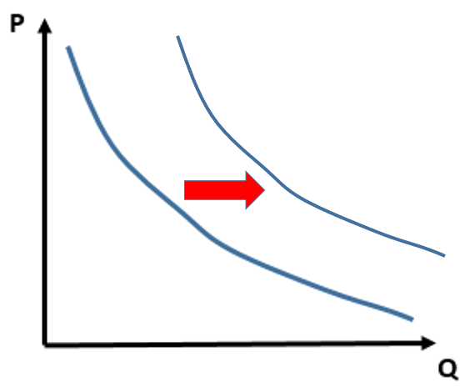
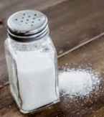
More Determinants of Demand - Effect of Income
An inferior good/service will be purchased
less when people have more income because they can now afford to buy better quality goods/services.
Eg. Public transport
When people’s income increases, they choose:
taxis
rental car
buy a car etc.
Disposable income is the total personal income of a worker/consumer minus income tax – how much they have to spend.
When incomes rise, normal goods see an increase in demand.
Eg. People buy more holidays to Europe when their income rises.
Many goods follow this pattern but not all.
For some goods, income has little effect on the quantity consumed such as goods/services that require a small portion of an individual’s income. Eg. salt
Even if your income increases or decreases, because salt is such a basic good and a small amount of our income, we would continue to buy the same amount.
Inferior goods : higher income = buy less
Normal goods : higher income = buy more
Small proportion of income goods = no effect

Slide 24









Substitutes vs Complements
Summary
Substitutes – you buy one or the other. ↑Price_{good X} → ↑Demand_{goodY}
Complements – bought together
Substitutes
A substitute is a product that can be purchased and used instead of another good. (competitive demand)
Example: Gas vs electric hotplates, Coke vs Pepsi
Complements
Complements are purchased together (joint demand)
Eg. Computers and a computer mouse, beer and peanuts, phones and phone apps.
↑Price of complement → ↓Demand
↑Price of substitute → ↑Demand

Slide 25
Determinants of Demand - Effects
Determinants of Demand | Increase | Decrease
Popularity and advertising | Demand shifts to the right → | Demand shifts to the left←
Population size | Demand shifts to the right → | Demand shifts to the left←
Taste, fashion, season | Demand shifts to the right → | Demand shifts to the left←
Interest Rate | Demand shifts to the left← | Demand shifts to the right →
Expectations of Price | Demand shifts to the right → | Demand shifts to the left←
Incomes (for a normal good) | Demand shifts to the right → | Demand shifts to the left←
Price of a substitute | Demand shifts to the right → | Demand shifts to the left←
Price of a complement | Demand shifts to the left← | Demand shifts to the right →

Slide 26
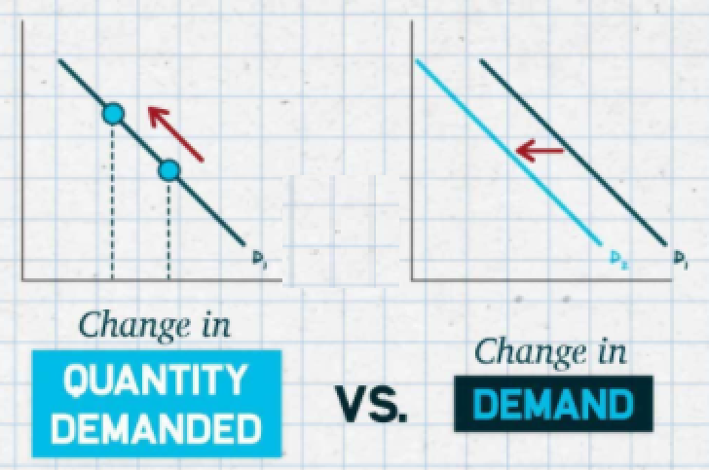

Slide 27
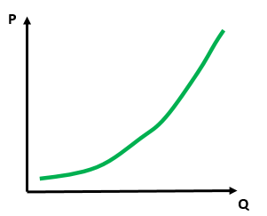
Law of Supply
You have a pizza restaurant with 4 employees and you can make 100 pizzas a day.
You make a new special sauce on your pizzas and suddenly people are lining up to buy your pizza and will pay a higher price.
What do you do? Do you keep on making the same number of pizzas?
Answer: No! You would hire more employees and maybe move into a bigger kitchen! So you could increase the number of pizzas you make.
Your Pizza Restaurant
Supply
Summary
Law of supply – the higher the price the larger the quantity supplied by producers

Slide 28
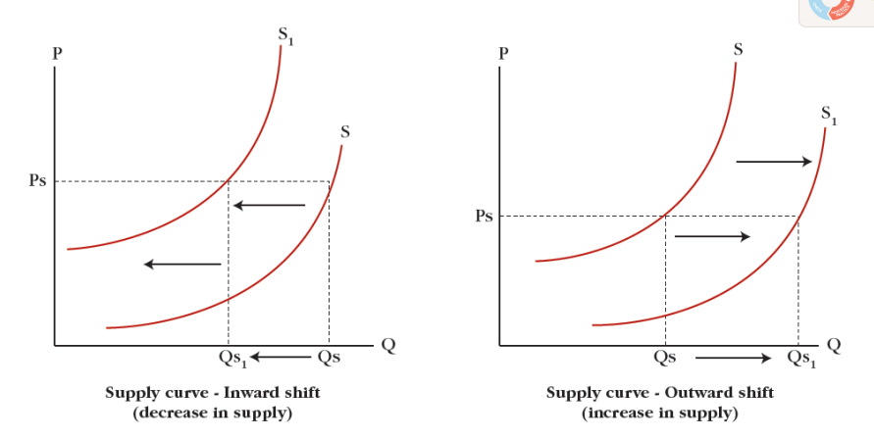
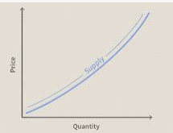
Change of Price
Non-price factors – Determinants of Supply
Higher price – a supplier will supply more.
Lower price – a supplier will supply less.
A supplier will move up and down the same curve based on the price offered.
These factors will increase or decrease the production, even if the price doesn’t change.
Therefore they cause a rightward or leftward shift of the supply curve
Extension
Contraction
Non-price factor examples
Price of resources/factors of production (eg. wages, oil price)
Number of producers in the market
Efficiency of production and productivity (eg. more skilled workers)
Technology
Expectations of sales
External factors
tax subsidies
financial grants
Weather etc.

Slide 29

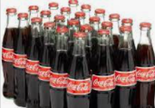
Ceteris Paribus
What is ‘ceteris paribus’?
It is a Latin expression which is also the language for abbreviations such as eg. = exempli gratia or ie. = id est
Ceteris paribus means ‘holding all else equal’
This is useful in situations where we want to analyze the effect of just one variable/factor.
If too many variables are changing then this is not a ‘good experiment’ and we will not be able to see the effect of the one variable.
Example – ‘Ceteris paribus, improvements in technology will help business to produce more than average.’
This means we should keep the size of the business, skill of workers, type of goods sold to be the same. (Because of course, if a very small business has high technology but very few workers then they may still produce less than other companies.)

Slide 30
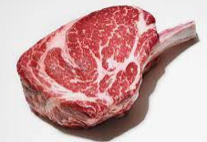

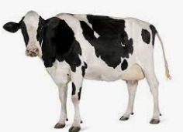
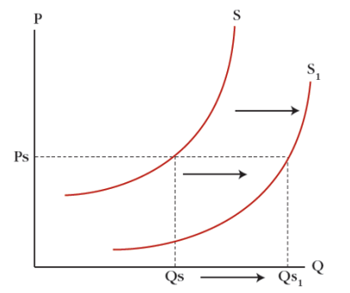


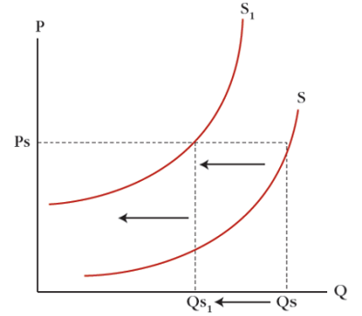

Effect of Changes to Substitutes/Complements
How does a change in the market for the substitute/complement affect the other market?
Complements in production
If more beef is produced then the supply of leather will also increase naturally.
↑Demand_{Beef} → ↑ Quantity Supplied_{Beef}
→ ↑ Supply_{Leather}
Substitutes in production
If more jet fuel is produced then the supply of plastic goods will fall because the oil will be used to make jet fuel instead of plastic toys.
↑Demand_{Jet} _{fuel} → ↑ Quantity Supplied_{Jet Fuel}
→ ↓ Supply_{Plastic} _{goods}

Slide 31
Determinants of Supply
Determinants of Supply | Increase | Decrease
Input Costs eg. raw material cost and wages | Supply shifts to the left← | Supply shifts to the right →
Efficiency in production | Supply shifts to the right → | Supply shifts to the left←
Productivity | Supply shifts to the right → | Supply shifts to the left←
Corporate Taxes | Supply shifts to the left← | Supply shifts to the right →
Subsidies | Supply shifts to the right → | Supply shifts to the left←
Technology | Supply shifts to the right → | Supply shifts to the left←
Expectations of Future Sales (eg. Halloween costumes) | Supply shifts to the right → | Supply shifts to the left←
Quantity produced of a substitute of production | Supply shifts to the left← | Supply shifts to the right →
Quantity produced of a complement of production | Supply shifts to the right → | Supply shifts to the left←

Slide 32
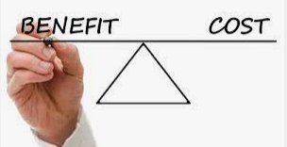
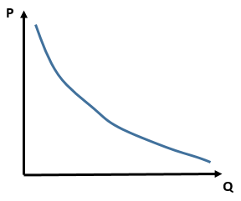
Demand and Supply Comparison
Demand
Shows the utility/benefit to consumers of each unit
Demand is a utility curve which shows willingness to pay
Slopes downward – Law of Demand
Supply
Shows the cost to producers of each unit
Supply is a cost curve
Slopes upward – Law of Supply
For both:
Change of price moves along the same curve
Change of other factors causes movement of the curve (left or right)

Slide 33
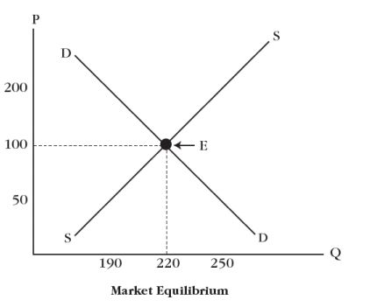
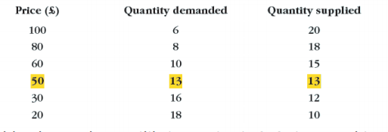
Equilibrium
Only at the price of $50 is the quantity demanded and the quantity supplied equal.
This is the equilibrium point.
Summary
The market naturally reaches an equilibrium where the quantity demanded = quantity supplied.

Slide 34
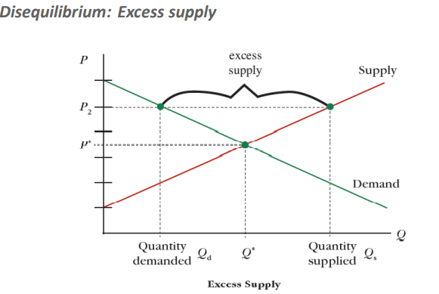
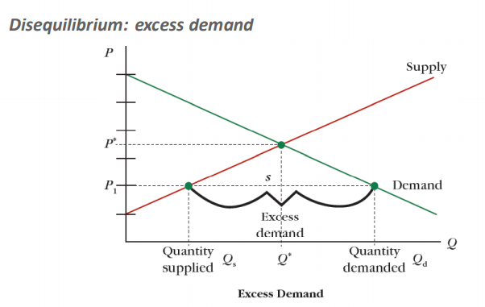
Price Mechanism
Excess Supply
Price too high
The market will naturally adjust to the equilibrium. But how?
In the case of excess supply, producers will not want to waste their production and will produce less and lower their price.
In the case of excess demand, producers will see they can sell more AND increase their prices and will do so accordingly.
Excess Demand
Price too low

Slide 35
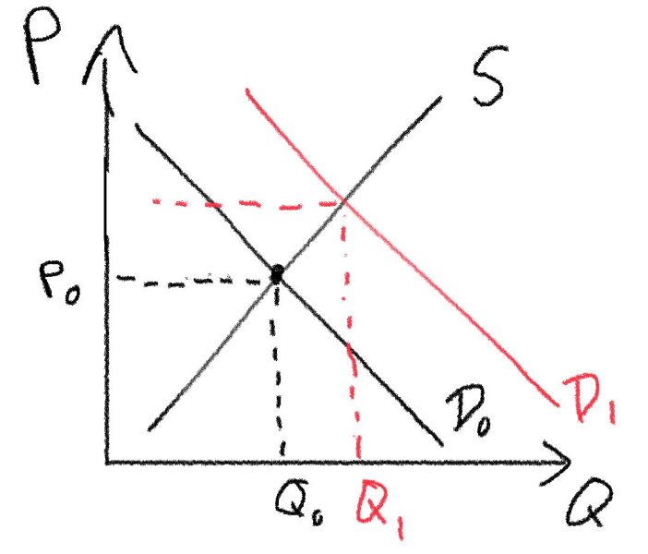
Changes in Equilibrium
The equilibrium point will always adjust to where demand and supply intersect.
Therefore, if there is any demand change or supply change it will create a new equilibrium point which is simply where the two curves intersect.
When we talk about a change in equilibrium point we should indicate changes to:
Price
Quantity
P₁
B
A
In the above example the change in demand moves us from:
Equilibrium point A to point B.
Price increased from P₀ to P₁
Quantity increased from Q₀ to Q₁

Slide 36
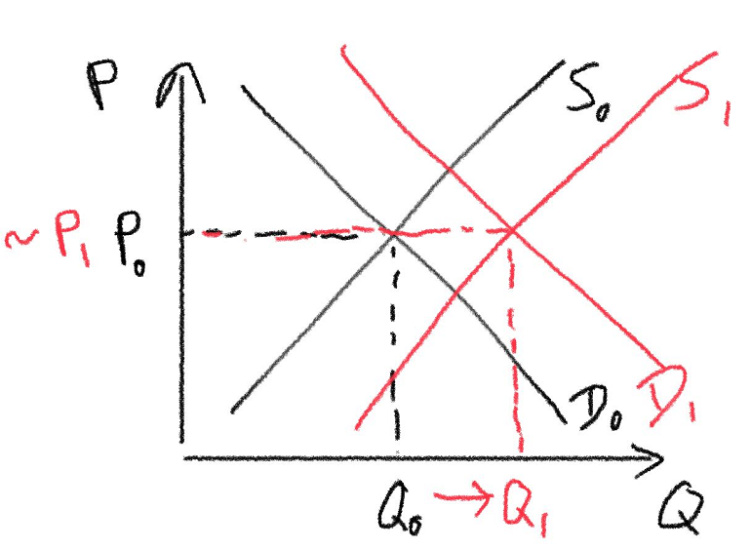
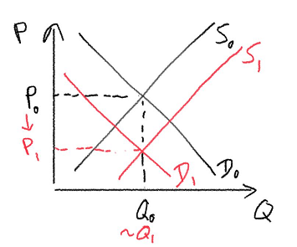
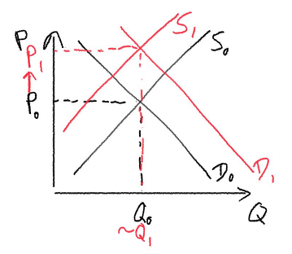
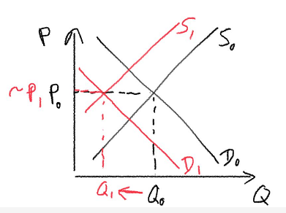
Double Shift Rule
Demand decreases, Supply Increases
↓ Demand → ↓ Price, ↓ Quantity
↑ Supply → ↓Price, ↑Quantity
Price definitely increases
Quantity Indeterminate
Demand Increase and Supply Increase
↑Demand → ↑Price, ↑Quantity
↑ Supply → ↓Price, ↑Quantity
Quantity definitely increases
Price Indeterminate
Demand decreases, Supply Decreases
↓ Demand → ↓ Price, ↓ Quantity
↓ Supply → ↑ Price, ↓ Quantity
Quantity definitely increases
Price Indeterminate
Demand Increases, Supply Decreases
↑Demand → ↑Price, ↑Quantity
↓ Supply → ↑ Price, ↓ Quantity
Price definitely increases
Quantity Indeterminate

Slide 37
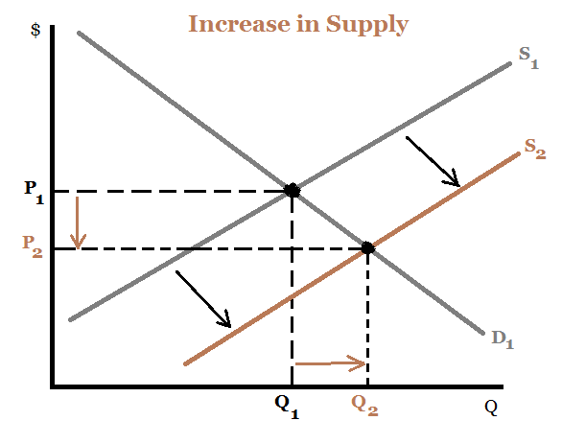
Effects Across markets
Market for Phones
Batteries are an input for phones.
Therefore there will be an increase in the supply of phones that creates a new equilibrium.
Market for Lithium
A discovery of lithium increases the supply of lithium
Lithium is an input for batteries, there will be an increase in the supply of batteries
Market for Batteries
Mobile Phones
In this case I would only recommend to draw the market for phones! (though you won’t be punished for drawing all)
Discovery lithium ↑Supply_{lithium}→
↑Supply_{batteries}→
↑Supply_{phones}→
New Equilibrium Market for Phones:
↑Quantity
↓Price
Summary
Market changes affect other markets, in this case because of the inputs used for different products.

Slide 38
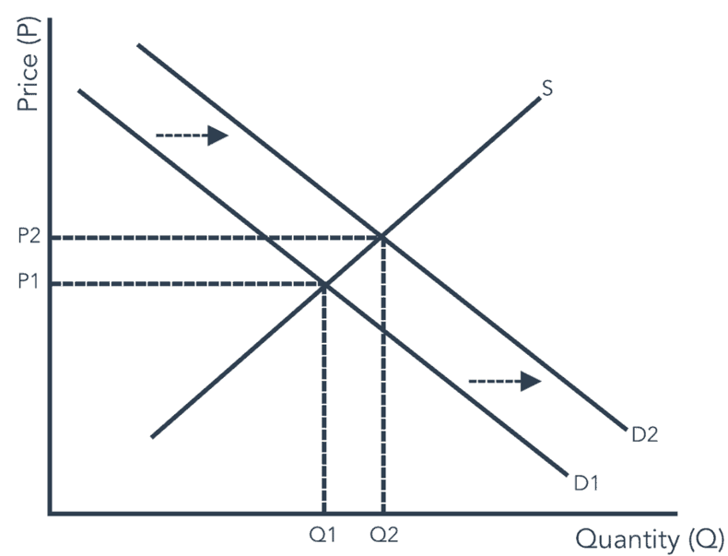
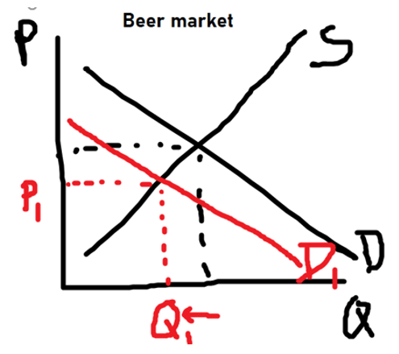
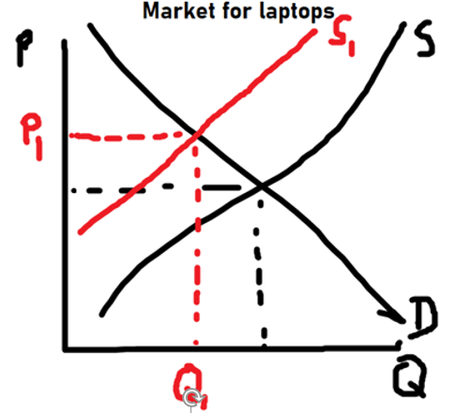
Demand for a Good Affecting the Resource
Resources can affect the market for a final good but the final good can also affect the resource!
Eg. Increased demand for coffee will increase demand for coffee beans.
Eg. A decrease in the production of pizza due to worker shortage will lead to less demand for cheese.
Market for Coffee
Market for Coffee Beans
Market for Pizzas
Market for Cheese
Summary
Goods can also affect the market for their resources.

Slide 39
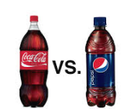
Market for Coke
Market for Pepsi
A contamination scandal at one of the coke factories causes a decrease of demand for coke to decrease, and fewer people buy coke.
Customers who would buy coke usually shift to Pepsi, increasing demand and quantity demanded.
Summary
Substitutes and complements can cause effects across markets.

Slide 40
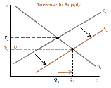
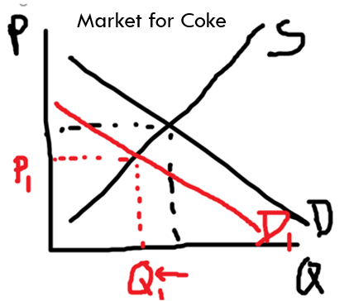


Cross Market Summary
Substitutes and Complements
Resources affecting the Good
Usually affects Supply
Goods affecting the Resource
Usually affects Demand
Mobile Phones

